Slide 1
Graphs
By: Sehajpreet Singh

Slide 2
Application of Graphs
Representing: Social Networks
Transportation networks, etc.
Graphs help in identifying contacts on social sites and suggesting them as friends on Facebook, where the nodes can be different users and the edges represent the relationships between them.
Graphs help in finding the shortest distance between any two given locations, where nodes can be the different locations in a city and edges represent the routes available between the locations.

Slide 3
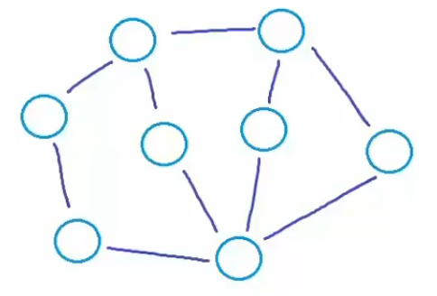
Introduction
Mathematical/Logical Notation:
A graph is an abstract data structure that represents the relationship between multiple nodes (entities) by connecting the nodes with edges.
G = (V, E) Here G is a graph which is a pair of two sets where:
V - It is a finite set of vertices (nodes).
E - It is a finite set of an ordered pair of the form (u, v) called an edge. The pair (u, v) indicates that there is an edge from vertex u to vertex v.

Slide 4
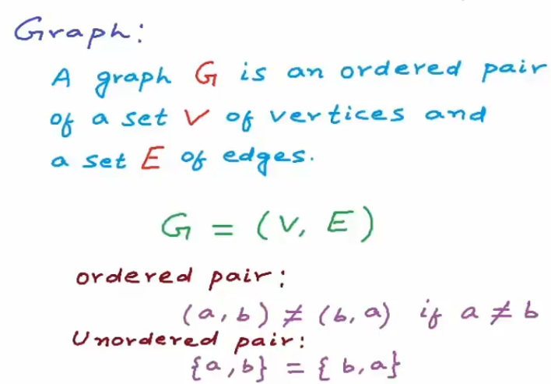
Introduction
Mathematical/Logical Notation:

Slide 5
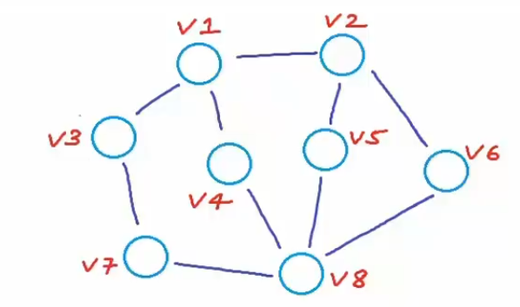
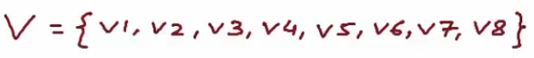
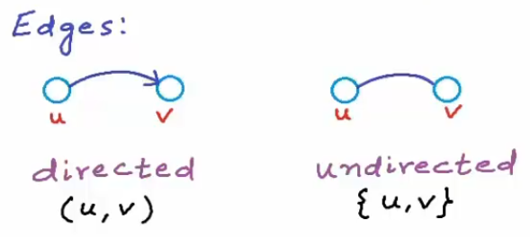
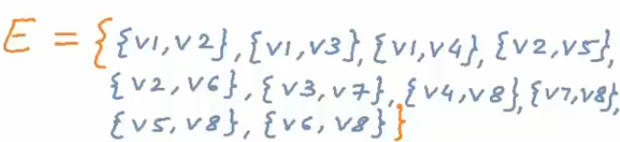
Introduction
Types of Edges:

Slide 6
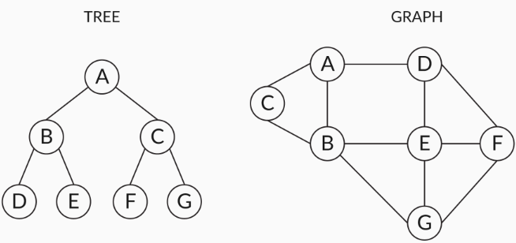
Restriction in Trees
Tree data structures have usage restrictions in representing real-world scenarios as each child node can have only one parent node, if there are N nodes then there will be exactly N-1 edges.
Graph data structures do not follow any restriction like that of the tree data structure on how different nodes are connected to each other.
Let’s look at the two data structures in the following diagram:

Slide 7
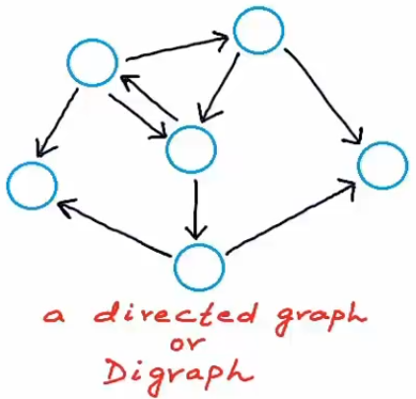
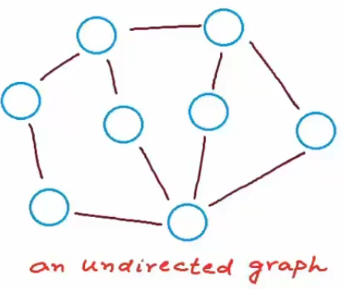
Classification of Graphs
Directed vs Undirected
Directed Graphs: That show an asymmetrical relationship b/w two connected nodes, paired by an edge that indicates the direction of the relationship from one node to another is called a directed graph.
Undirected Graphs: Graphs that show a symmetrical relationship between two connected nodes paired by an edge that represents a simple line is called an undirected graph.

Slide 8
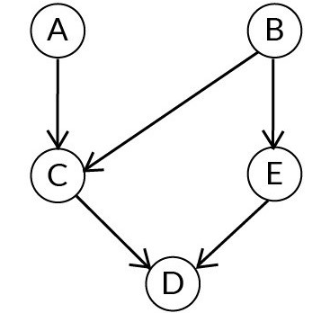
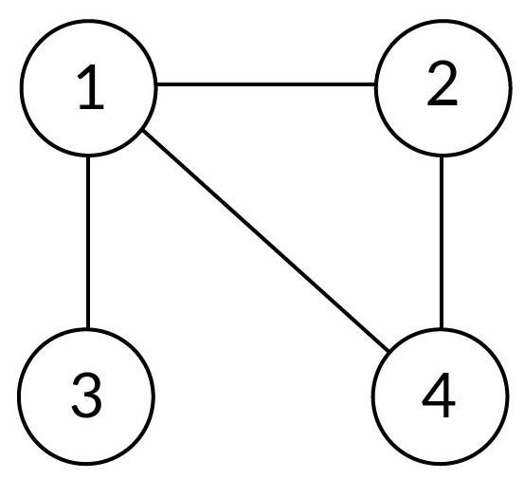
Classification of Graphs
Directed vs Undirected
Directed Graphs
Undirected Graphs
G for the above graph is (V, E) where
V = {A, B, C, D, E}
E = {(A, C), (B, C), (C, D), (E, D), (B, E)}
G for the above graph is (V, E) where
V = {1, 2, 3, 4}
E = {(1, 2), (2, 4), (4, 1), (1, 3)}
Note: The pair representing the edge is ordered and (u,v) ≠ (v,u) in case of a directed graph (digraph) and in case of an undirected graph the order does not matter

Slide 9
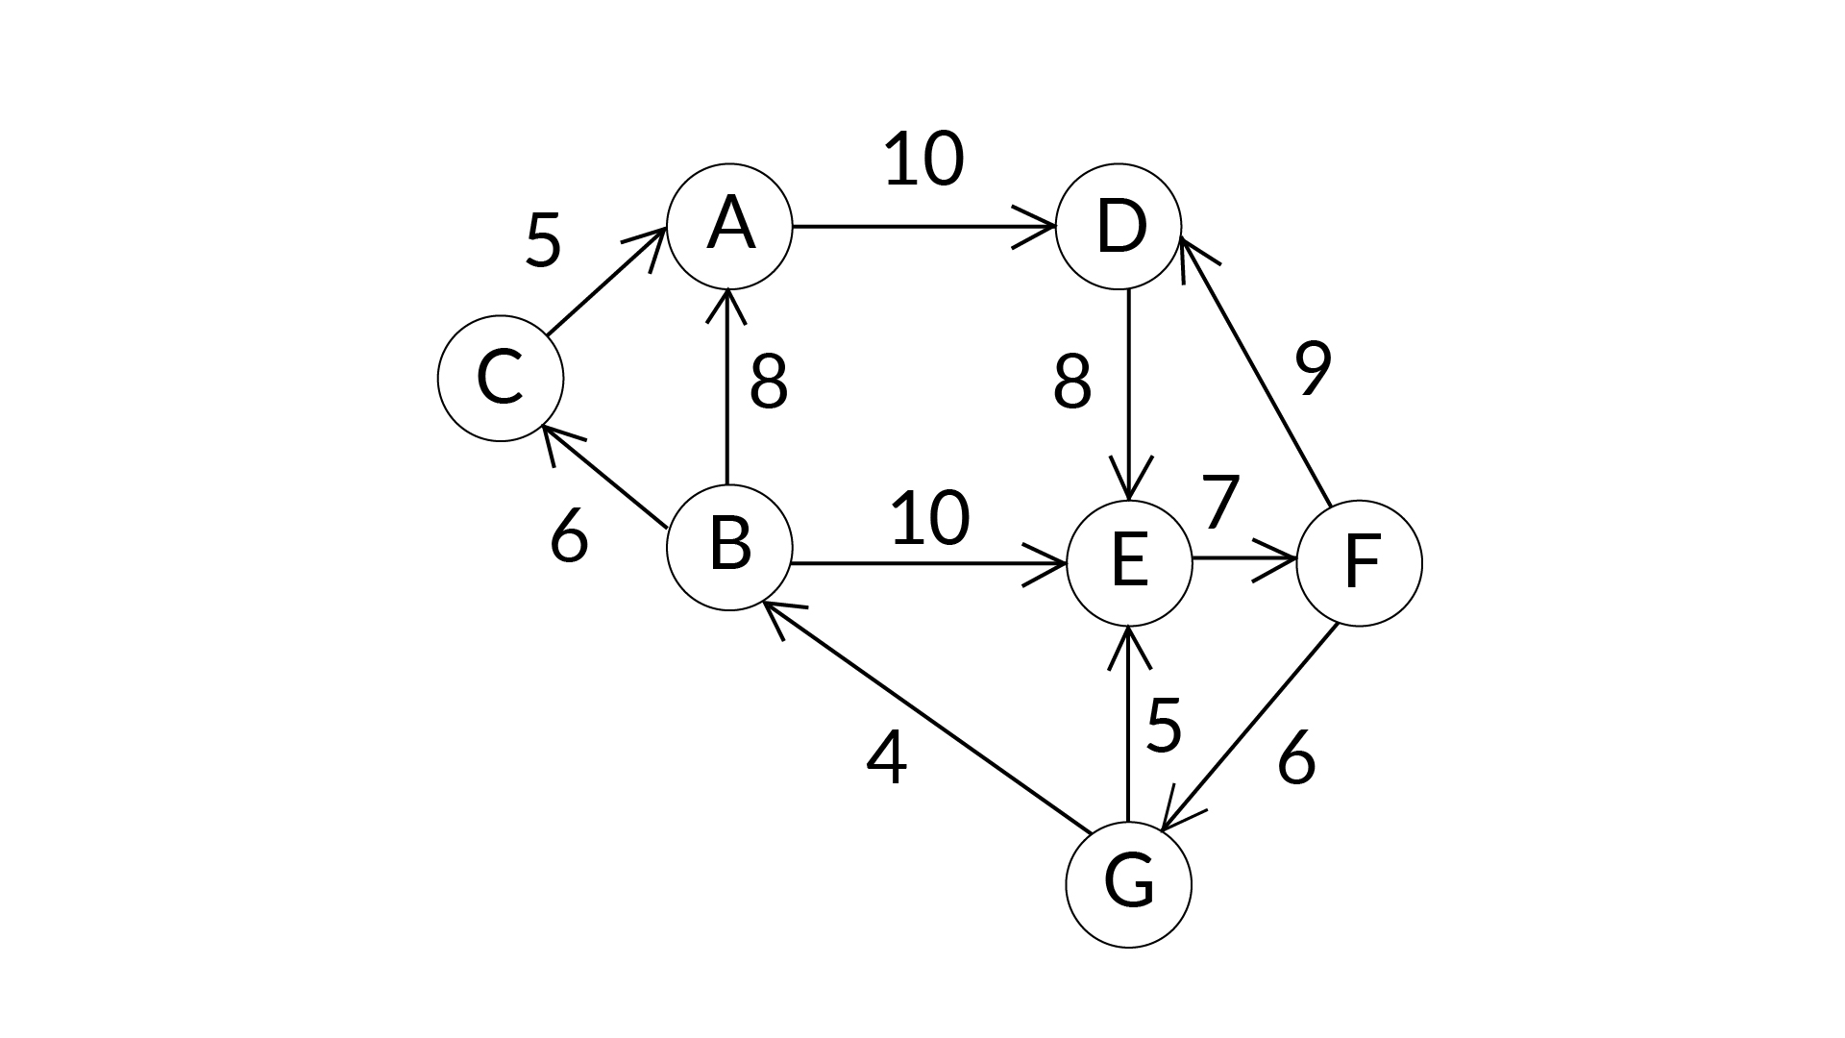
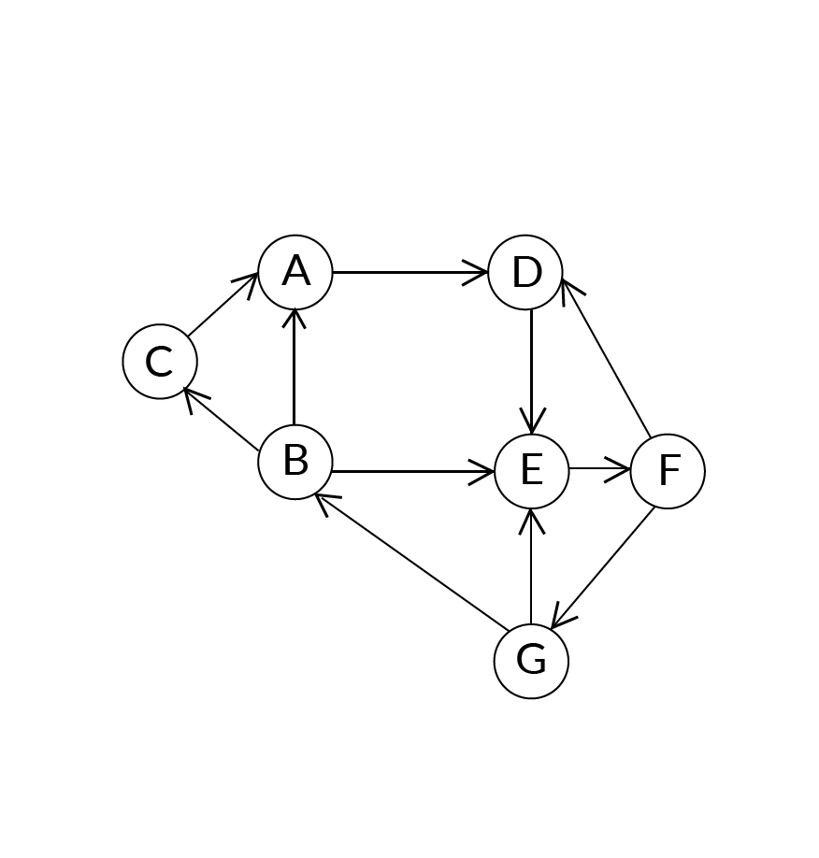
Classification of Graphs
Weighted vs Unweighted
Weighted graph: A graph in which edges contain some weights or values is called a weighted graph.
Unweighted graph: A graph in which edges contain no weight is called the Unweighted graph.
Example: If the nodes in the graph are considered as the cities and edges considered as the paths between them then the weights of these edges can be considered as the distance between these cities.
Or, A weighted graph with all edges having weight = 1 unit.

Slide 10
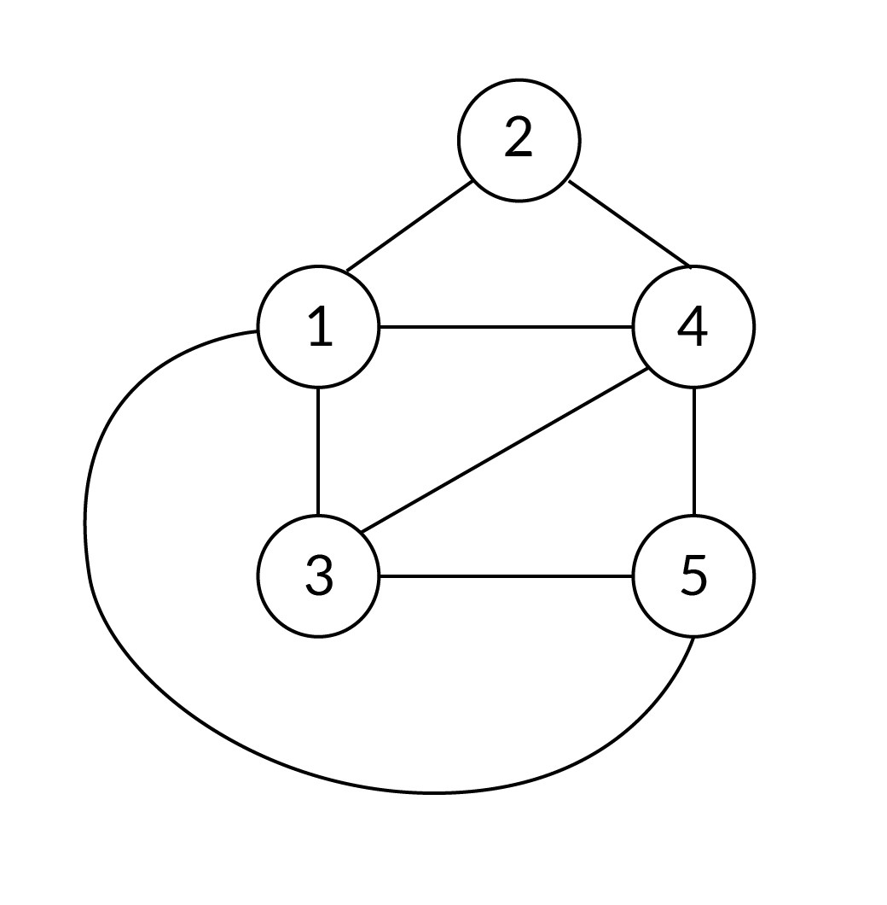
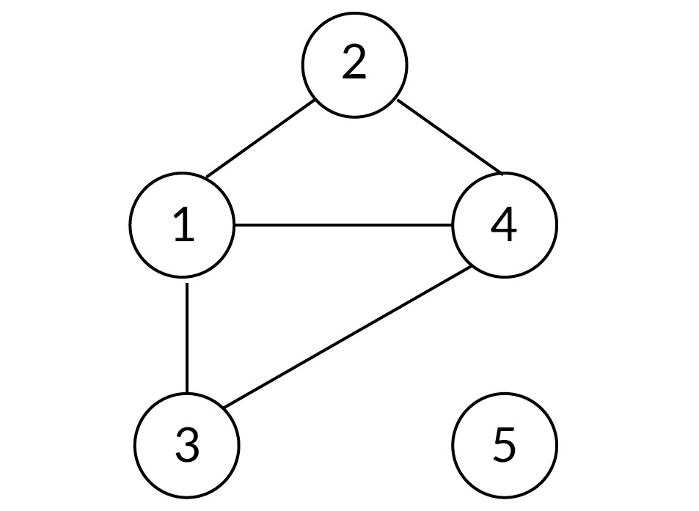
Classification of Graphs
Based on Connectivity
Connected Graph: A Graph is connected if a path exists from every vertex to every other vertex.
Disconnected Graph: A Graph is disconnected if there exist at least two nodes such that there is no path connecting them.

Slide 11
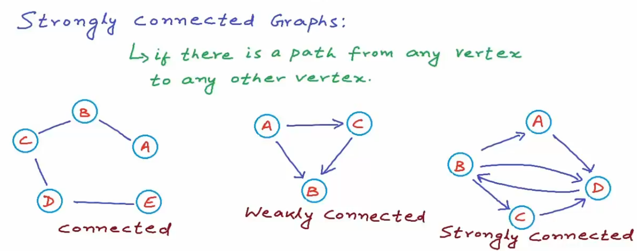
Classification of Graphs
Based on Connectivity

Slide 12
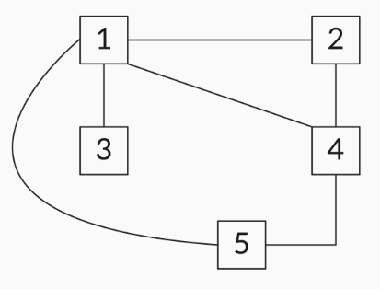
Properties of Graphs
Neighbours: If two nodes are adjacent to each other and connected by an edge, then those nodes are called neighbours.
Degree: The number of edges that are connected to a node is called the degree of the node.
Let’s consider the following undirected graph. We will discuss how to determine the degree of each node.

Slide 13
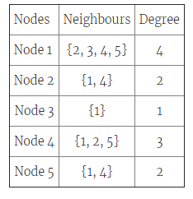
Properties of Graphs
In case of directed graphs, the degree can be classified into:
In-degree: The number of incoming edges to a node
Out-degree: The number of outgoing edges from a node
For a directed graph: Degree = InDegree(the edges pointing to the vertex) + OutDegree(the edges pointing away from the vertex)

Slide 14
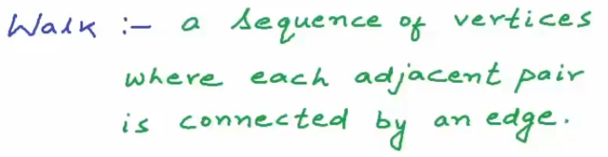
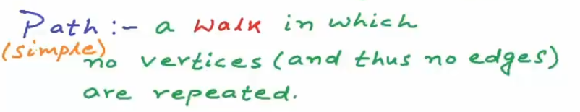
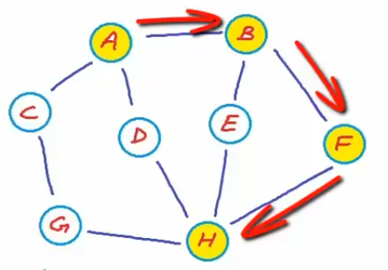
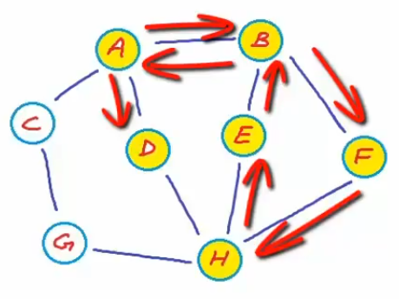
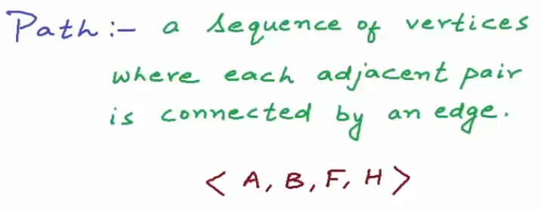
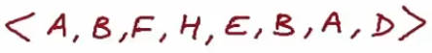
Properties of Graphs
Also a Simple Path
Not a Simple Path

Slide 15
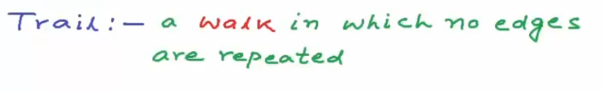
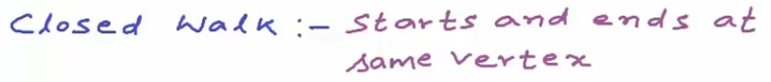
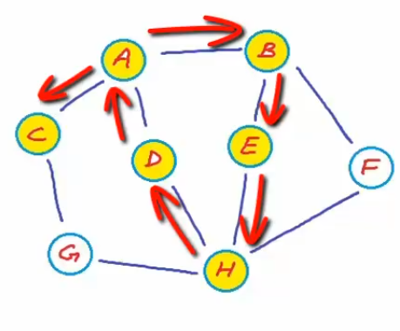
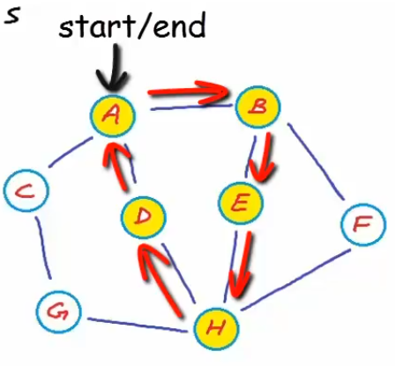
Properties of Graphs

Slide 16
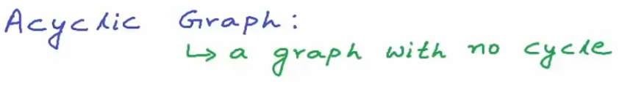
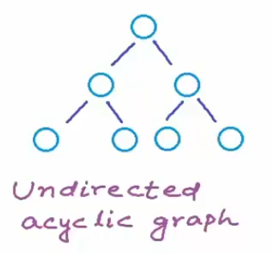
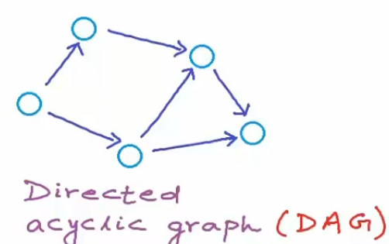
Properties of Graphs

Slide 17
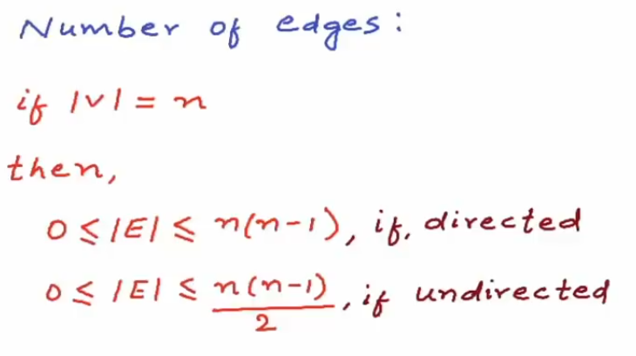
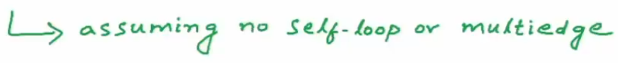
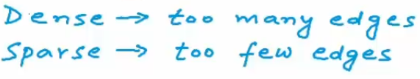
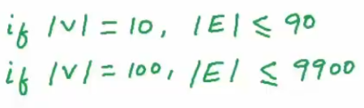
Properties of Graphs

Slide 18
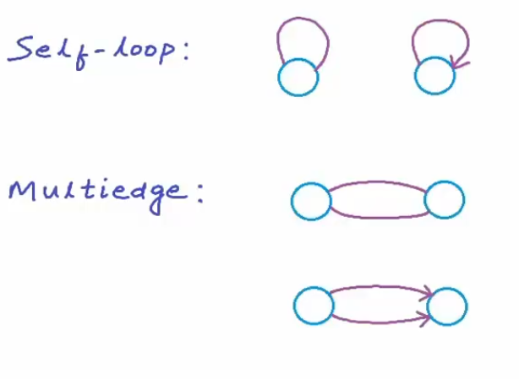
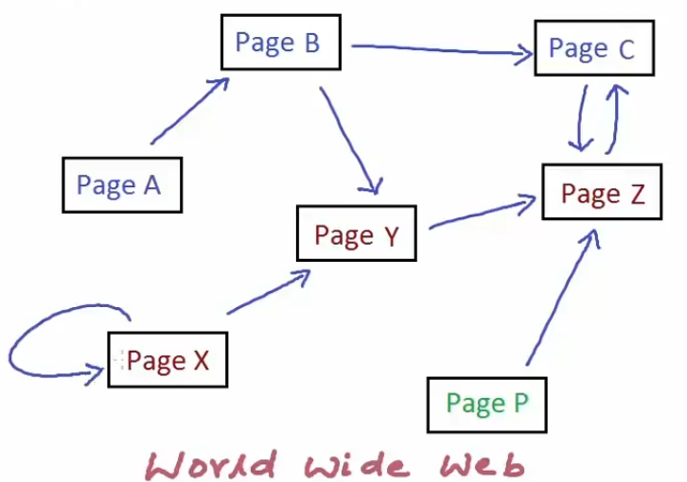
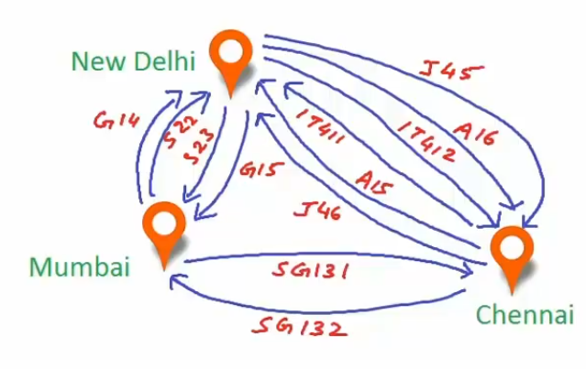
Properties of Graphs

Slide 19
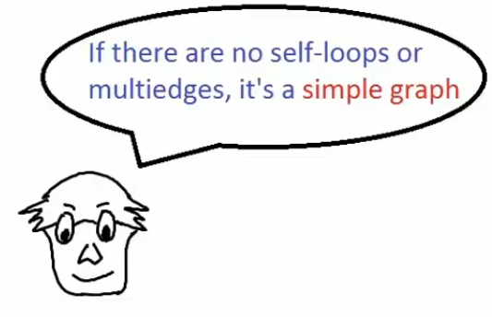
Properties of Graphs

Slide 20
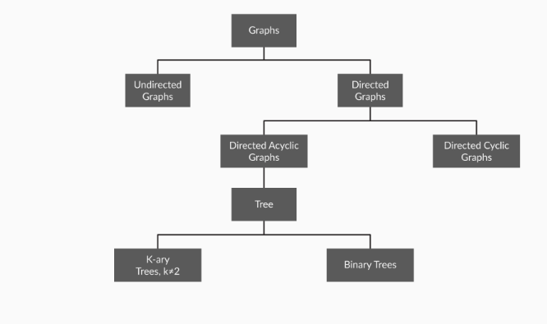
Classification of Graphs
Table

Slide 21
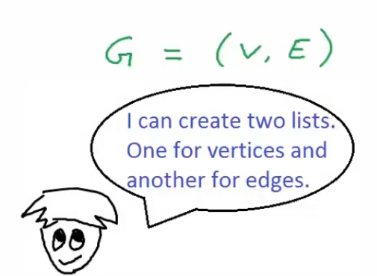
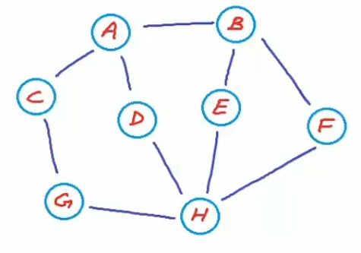
Representation of Graphs
Edge List Representation

Slide 22
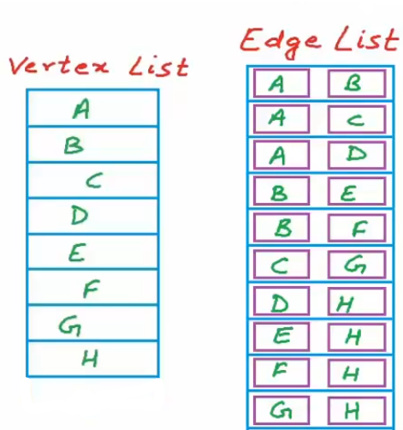
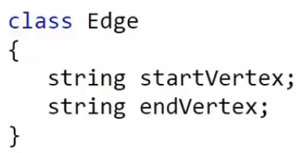
Representation of Graphs
Edge List Representation

Slide 23
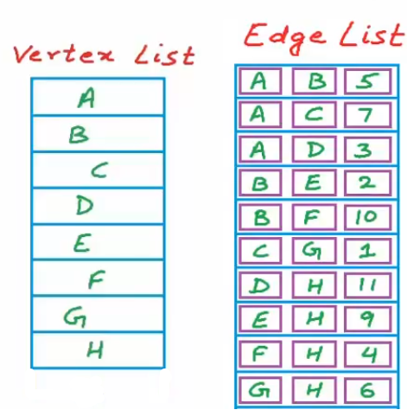
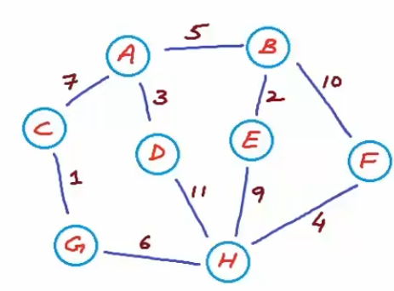
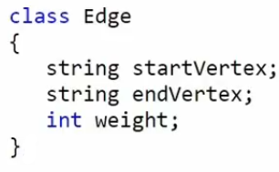
Representation of Graphs
Edge List Representation

Slide 24
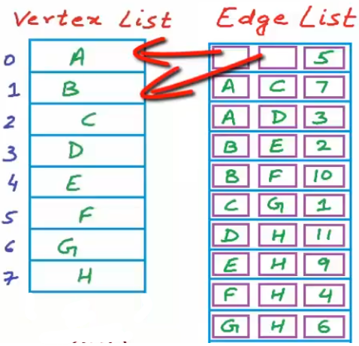
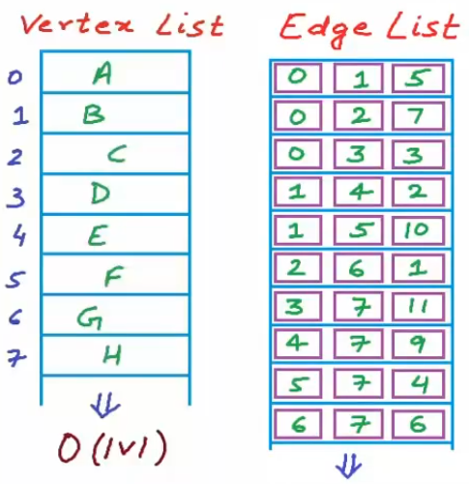
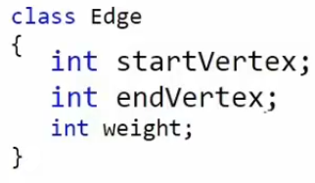
Representation of Graphs
Edge List Representation – A better Representation

Slide 25

Representation of Graphs
Edge List Representation

Slide 26




Representation of Graphs
Edge List Representation – Cost of Operations

Slide 27




Representation of Graphs
Adjacency Matrix Representation

Slide 28


Representation of Graphs
Adjacency Matrix Representation – Cost of Operations

Slide 29



Representation of Graphs
Adjacency Matrix Representation – Cost of Operations

Slide 30

Representation of Graphs
Adjacency Matrix Representation – When favorable?

Slide 31




Representation of Graphs
Adjacency List Representation

Slide 32


Representation of Graphs
Adjacency List Representation – Cost of Operations
But, we already know that we won’t hit the worst case, so we’ll be really saving a lot in terms of time.

Slide 33

Representation of Graphs
Adjacency List Representation

Slide 34

Representation of Graphs
Adjacency List Representation
A better approach to increase the neighbour for any node, i.e. add an edge in the graph.

Slide 35

Representation of Graphs
Adjacency List Representation
If the edges are weighted.

Slide 36
Implementation of Graphs
Adjacency List Implementation using LinkedList

Slide 37

Sets & Maps
Sets
A set is a collection of unordered elements without any duplicates.
Properties:
Unlike lists and stacks, the elements present in a set do not follow any particular order. They are randomly present in the set.
The elements are not repeated in a given set.
Usage: A set can be used to determine if a node is a neighbour of another node i.e. if you store all of node A’s neighbours as a set, you can use the contains() method to quickly find out if a node named X is a neighbour of node A.

Slide 38
Sets & Maps
Maps
Maps represent a collection type that provides connection or mapping between the elements of a source set (domain) and a target set (range). A Map cannot contain duplicate keys and each key can map to at most one value.(Keys are unique but values can be repeated)
Methods in Map Interface:
public Object put(Object key, Object value): This method is used to insert an entry in this map.
public void putAll(Map map): This method is used to insert the specified map in this map.
public Object remove(Object key): This method is used to delete an entry for the specified key.
public Object get(Object key):This method is used to return the value for the specified key.
public boolean containsKey(Object key): This method is used to search the specified key from this map.
public Set keySet(): This method is used to return the Set view containing all the keys.
public Set entrySet(): This method is used to return the Set view containing all the keys and values.

